Slide 1
Heather Gauck Resource Teacher-GRPS
@heathergauck
gauckh@grps.org

Slide 2
What is Seesaw?
Watch the video to see how students describe Seesaw!

Slide 3
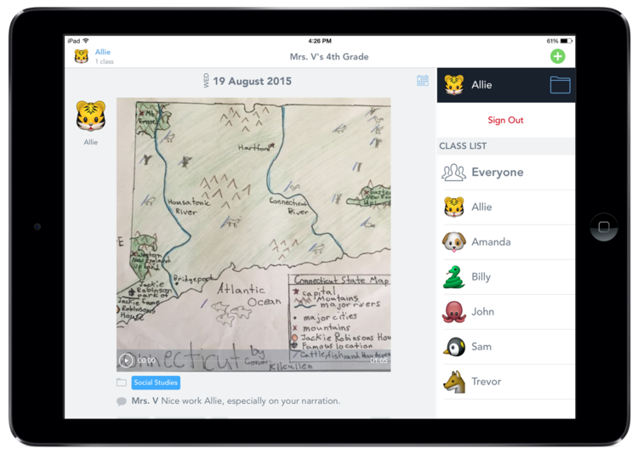
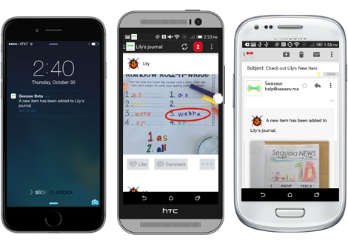
Why are We Using Seesaw?
Document learning as it happens
Empower students to think deeper and reflect
Teach digital citizenship and 21st century skills
Build an organized record of student work
Create a community around learning
Involve families in real time
Notes:
Edit these to match your school’s learning goals.

Slide 4
Goals of This Session
Today we’ll learn how to use the basic features of Seesaw in our classrooms.
Goal 1: We will set up individual teacher accounts.
Goal 2: We will be able to independently sign in to Seesaw and navigate basic options in the program.
Goal 3: We will learn how to publish content to student journals using Seesaw’s built-in tools.
Notes:
Edit these to match your school’s learning goals.

Slide 5
Download Seesaw and Sign in
Step 1: Make sure you have installed Seesaw on your teaching device.
Download iOS or Android app.
Bookmark Seesaw on the web. Use Firefox or Chrome browser.
Step 2: Sign in as “I’m a Teacher”
Choose “I’m a Teacher” and sign in using your school email address
Set up account
Click top right green check
Step 3: Complete the next 3 activities to learn how to add items to Seesaw
To add your first piece of work, tap the green + (top right)

Slide 6
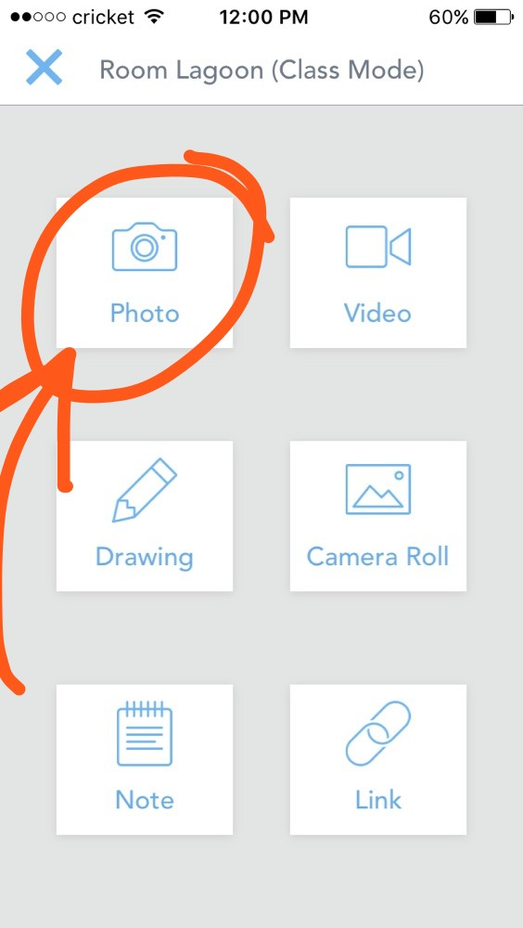
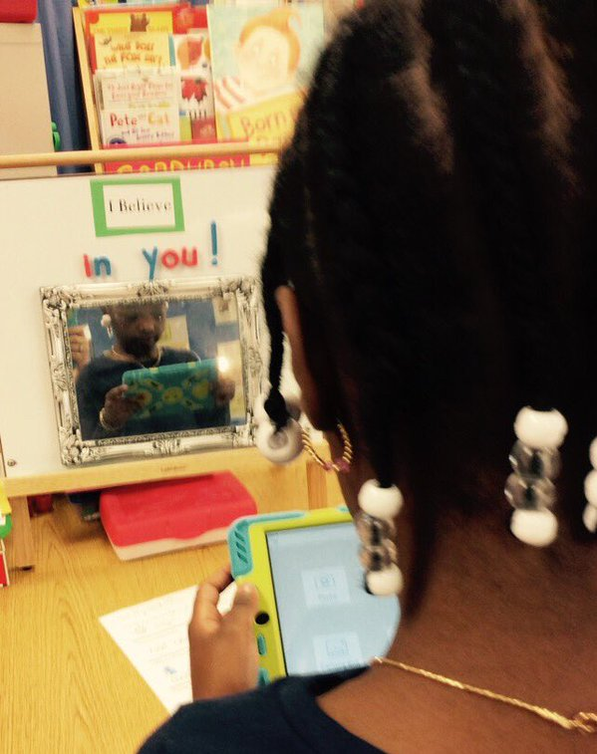
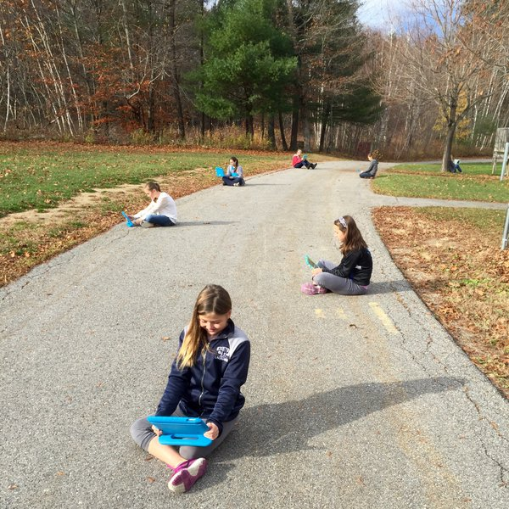
First Project: Take a photo
Take a ‘selfie’ or a photo of something in the room.
Use the Photo item type.
Use the built-in annotation tools to add layers of content to your work.
Record a voice annotation or text tool to write a caption for the picture.

Slide 7
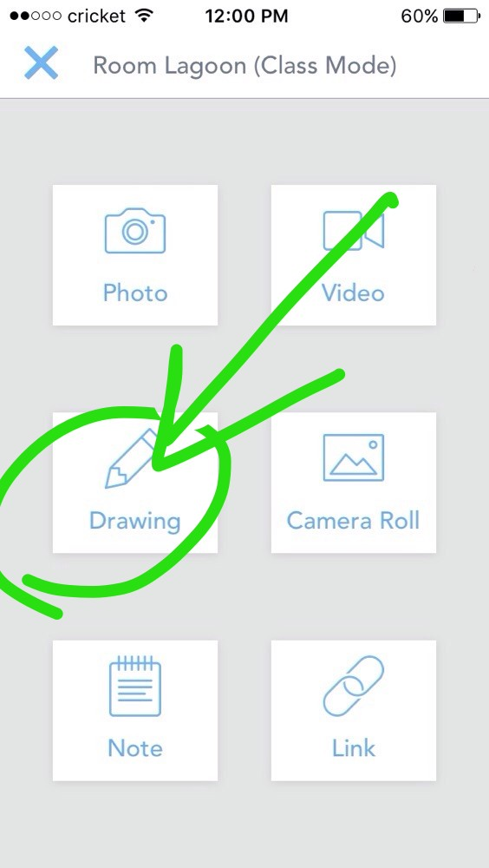
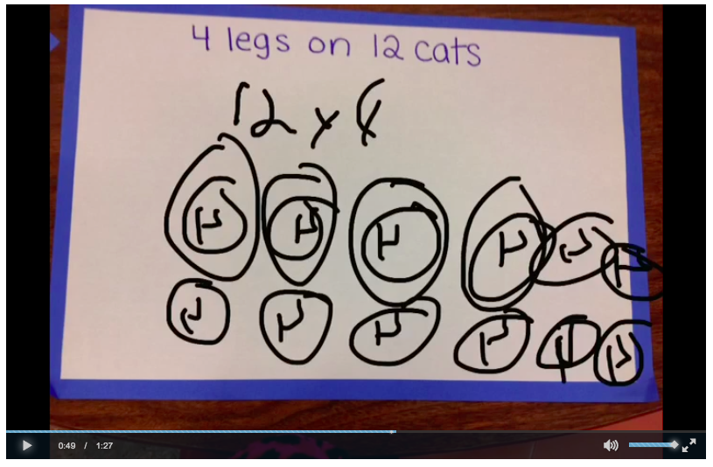
Second Project: Solve a Math Problem
Solve a math problem.
Use the Drawing item to work through a sample problem.
On iOS devices, use the recordable whiteboard tool to draw + record at the same time
Use the built-in annotation tools to add layers of content to your work.
Record a voice annotation explaining how to solve the problem.

Slide 8
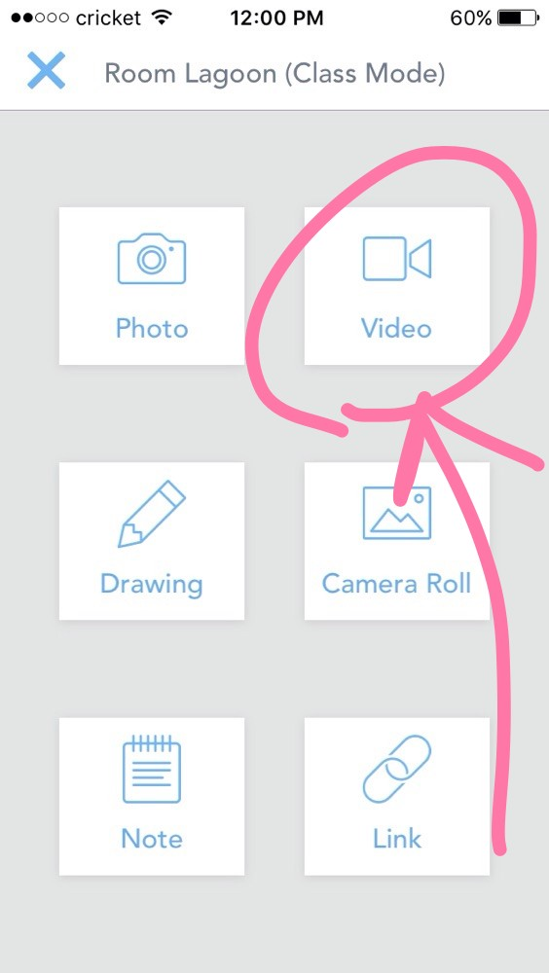
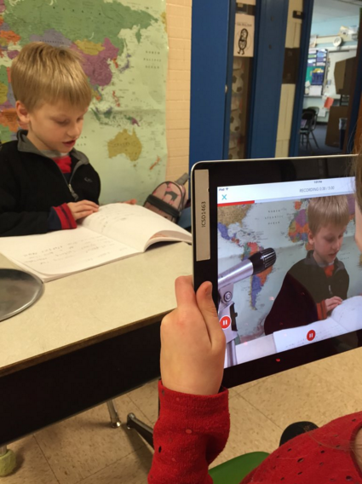
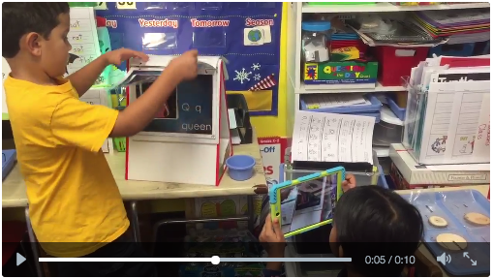
Third project: Reading Recording
Record a partner reading a book (or paragraph) aloud, then swap.
Use the Video item type.
Use the built-in annotation tools to add layers of content to your work.
Type a text caption explaining the key message of the book.

Slide 9
Awesome job!
Now you’ve seen first hand how students will add items to their Seesaw Journals!

Slide 10
Examples from Classroom~
Notes Home to Parents
Creative Way to Give Spelling Tests
Hear the Student's Thinking
Evidence of Learning
Camera Roll with other Apps
Notes:
Edit these to match your school’s Seesaw goals.

Slide 11
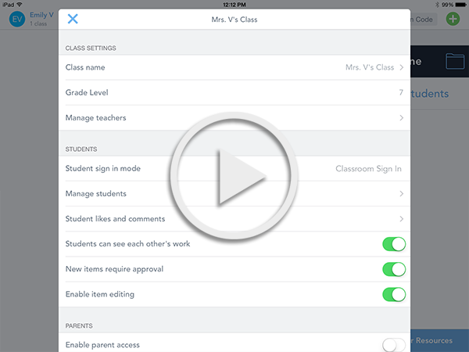
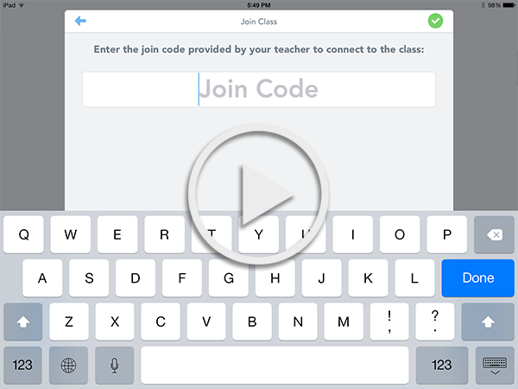
Class Setup and Class Settings Help
If you need help setting up your Seesaw class or changing class settings, use these resources.
Follow the Class Setup Checklist
Watch how to set up a Class Code Class video
Watch how to set up an Email Class video
Notes:
If you do not want teachers to change any class settings, remove this slide.

Slide 12
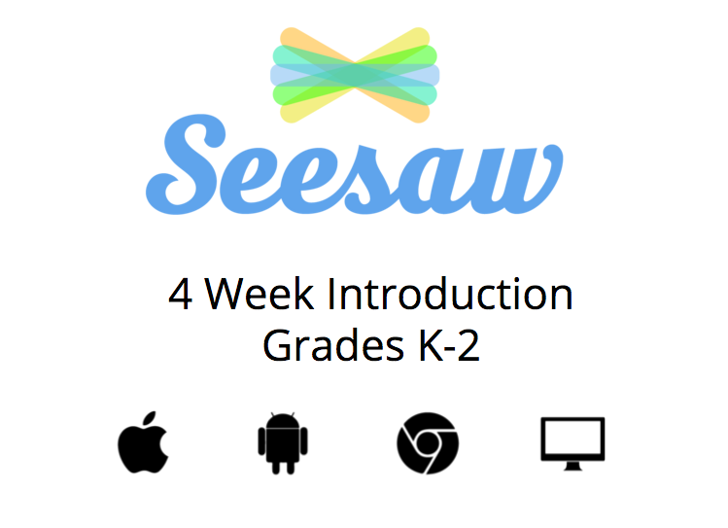
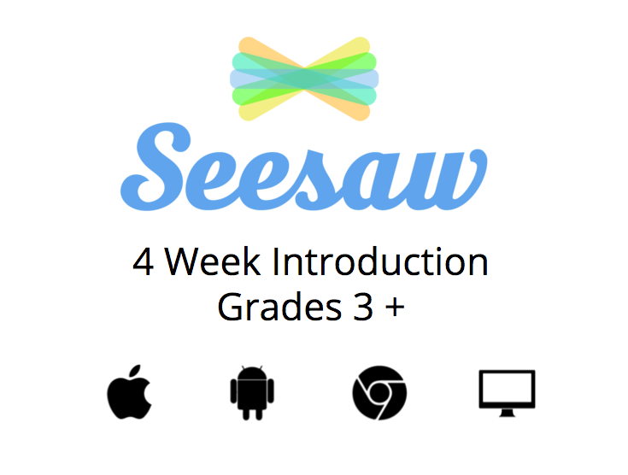
Additional Resources for Seesaw Success
Watch the Seesaw tutorial videos to learn more about Seesaw features
Use the Seesaw student intro presentation to introduce Seesaw to your students
Use the K-2 Lesson Plan or 3-8 Lesson Plan to guide your first month of using Seesaw

